Slide 1
Timetables and speed

Slide 2
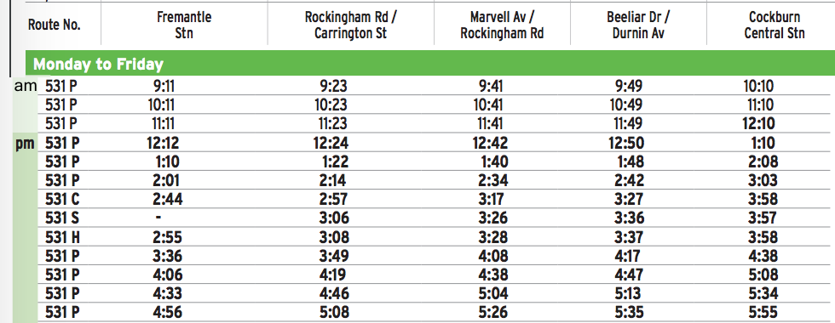
Topic: Timetable reading
EQ: How do I read a timetable and plan a journey
When planning a journey on public Transport, you need to have a timetable of when buses or trains are arriving or departing.
When reading a timetable, most timetables have a fixed point, often called timed stops.
From these time tables we can plan our journey effectively.
The timetable left is for the 531 bus from Fremantle to Cockburn.
It lists 5 fixed bus stops along the journey as time markers.

Slide 3
Reading an interpreting
If I want to get to Cockburn from Carrington Street/ Rockingham Road by 3:10 for a coffee date, what is the latest time I can leave?
1- Find the time that the bus gets to Cockburn before 3:10 pm.
2- Follow the row across to the Rockingham Road/Carrington Street.
3- Plan your arrival to the bus station from there

Slide 4
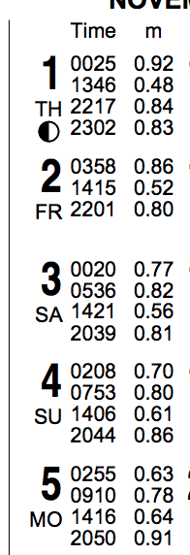
Tide tables
Tide tables list the low and high tide times each day, and the height of the water. It also lists the time that these wold change.
Tides are also dictated by the phases of the moon, and as such we can use these to solve these problems.
Looking at the list from the first 5 days of November, which day has the highest tide and at what time?
Some days have two or three times, why do you think that would be the case?

